Slide 1

Survival analysis

Slide 2


Slide 3

Special data
Notes:
Survival data are a special type of data, and therefore have to be analyzed with special methods

Slide 4

Variable – time to event : Hybrid Variable
Notes:
Explosives of poor quality
Will they explode ??
When ??

Slide 5
Question
Which of the following data sets is likely to lend itself to survival analysis?
A case-control study of caffeine intake and breast cancer.
A randomized controlled trial where the outcome was whether or not women developed breast cancer in the study period.
A cohort study where the outcome was the time it took women to develop breast cancer.

Slide 6

Why bother ?
Why not use linear or logistic regression?
Notes:
In logistic regression, we were interested in studying how risk factors were associated with presence or absence of disease.
If there is no dropouts ( censoring, remember this word) , standard regression procedures could be used.
However, these may be inadequate because
– Time to event is restricted to be positive and has a skewed distribution.

Slide 7
Question
1- Why not compare proportion of events in your groups using risk/odds ratios or logistic regression?
2- Why not compare mean time-to-event between your groups using a t-test or linear regression?
Notes:
1- ignores TIME
2- ignores CENSORING

Slide 8
Censoring
3 main reasons
no event before the study ends
lost to follow-up during the study period
withdrawals from the study
These are all examples of right-censoring.

Slide 9
Types of Censoring
Right Censoring
Left Censoring
Interval Censoring
Start of Study
End of participation in the Study

Slide 10
Types of Censoring
Right Censoring
Left Censoring
Interval Censoring
Start of Study
End of Study
Notes:
An individual is said to be left censored if the patient had been on risk for disease for a period before entering the study. However, left censoring is usually not a problem in clinical trials, since starting point is defined by an event such as entry of patient in trial, randomization or occurrence of a procedure or treatment.

Slide 11
Types of Censoring
Right Censoring
Left Censoring
Interval Censoring
0
2
4
6
8
End of Study
Start of Study
Notes:
Point censoring is said to occur when despite continuous monitoring of outcome event, the patient is lost to followup or the event does not occur within the study duration
interval censoring arises when time to event may be known only up to a time interval. This situation occurs in case the assessment of monitoring is done at a periodical frequency
This is illustrated by a hypothetical study done to ascertain the incubation period of AIDS after occurrence of HIV infection
Practically, most observational studies dealing with non-lethal outcomes have periodical examination schedules and are thus interval censored. However, if the periodicity of examination is at a justified frequency, interval censored data can be dealt with as point censored

Slide 12

Rule 1”Non informative censoring”
Random (or non-informative) censoring is when each subject has a censoring time that is statistically independent of their failure time
Notes:
Regardless of the type of censoring, we must assume that it is non-informative about the event; that is, the censoring is caused by something other than the impending failure.

Slide 13
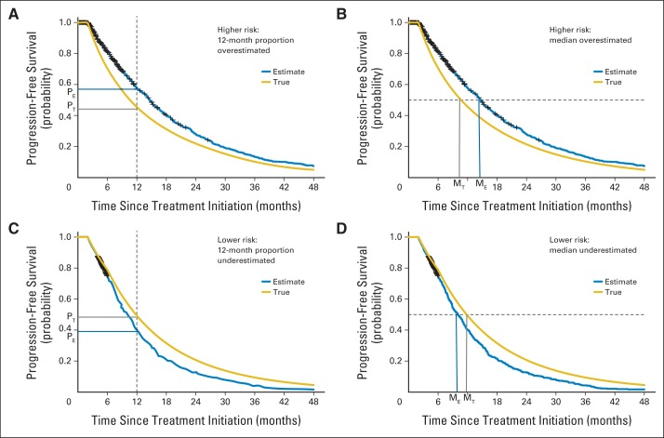
Notes:
The anticipated direction of the bias in the 12-month and median progression-free survival (PFS) estimates is shown when patients who come off study are at a higher risk for progression (A, B) or a lower risk for progression (C, D). The yellow line represents the true but unknown PFS. The blue line represents the PFS estimate using the Kaplan-Meier method

Slide 14

12 vs 8 months
12.6 mo vs 8.3 mo
Notes:
patients with Waldenström macroglobulinemia (WM) may be taken off study because of inadequate response or initial signs of clinical progression without satisfying protocol-defined progression criteria.
In a relapsed/refractory WM phase II study²¹ in which 35% of the patients initiated nonprotocol therapy (NPT) before progression, the estimated median PFS with patients censored at the time of NPT was 12.6 months whereas the estimated median event-free survival (EFS), which assumes NPT initiation as an event, was 8.3 months
A side note :
Phase II clinical trials aim to identify promising therapies for comparison with standard treatment in randomized phase III trials. These studies are often single-arm, open-label clinical trials with the goal of evaluating the impact of treatment on short-term tumor burden measures such as response rates and long-term measures such as progression-free survival (PFS), as well as further evaluating the safety profile of the treatment among a group of patients who are likely to participate in a phase III trial. In these trials, patients may be taken off study before progression for reasons such as toxicity, patient or physician preference, initiation of nonprotocol therapy, or inadequate response. If, in a Kaplan-Meier (KM) analysis¹of PFS, these observations are censored at the time patients went off study, and the censored patients are at a different risk for treatment failure than those who remain on study, one of the key assumptions of the KM method, called noninformative censoring, is violated.

Slide 15
Clearly stated
Objectives
Estimate time-to-event for a group of individuals
To compare time-to-event between two or more groups
To assess the relationship of co-variables to time-to-event
Notes:
Groups as AML to ALL
Co-variables such as: does weight, gender, or tumor site influence survival time of cancer patients?

Slide 16


Slide 17
Kaplan-Meier Approach
Rule No 2 : remember no 1?
survival probabilities are comparable in participants who are recruited early and later into the study
Notes:
KM re-estimates the survival probability each time an event occurs.
Keep the re-estimation point in mind
Different survival probability assumption may be tested, provided we have enough data to estimate survival probabilities in different subsets of the data and, if necessary, adjusted for by further analyses
https://www.ncbi.nlm.nih.gov/pmc/articles/PMC2394262/

Slide 18


Notes:
3aboood : enta moraba3 wa7ed ,,, several regimens across different times …example osteo
Early detection better survival

Slide 19
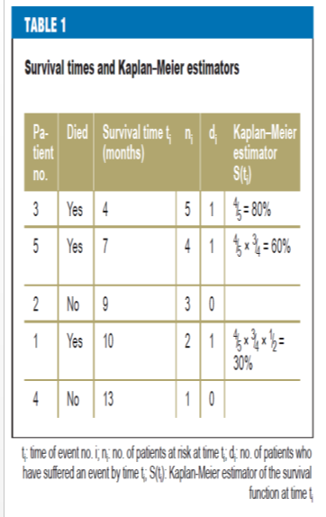
Notes:
Patients’ survival times are plotted on the x-axis, and the probability of survival calculated according to the Kaplan–Meier method is plotted on the y-axis.
Survival rates indicate the number of patients in whom no event has occurred up to a certain point in time.
This can be interpreted from the graph as follows: one year after diagnosis, we can expect 30% of patients to be still alive. When stating survival rates, it is important to also state the point in time to which it corresponds. When comparing two treatment groups, it is advisable to plot Kaplan–Meier curves for both treatment groups, as these provide more information than survival rates alone

Slide 20
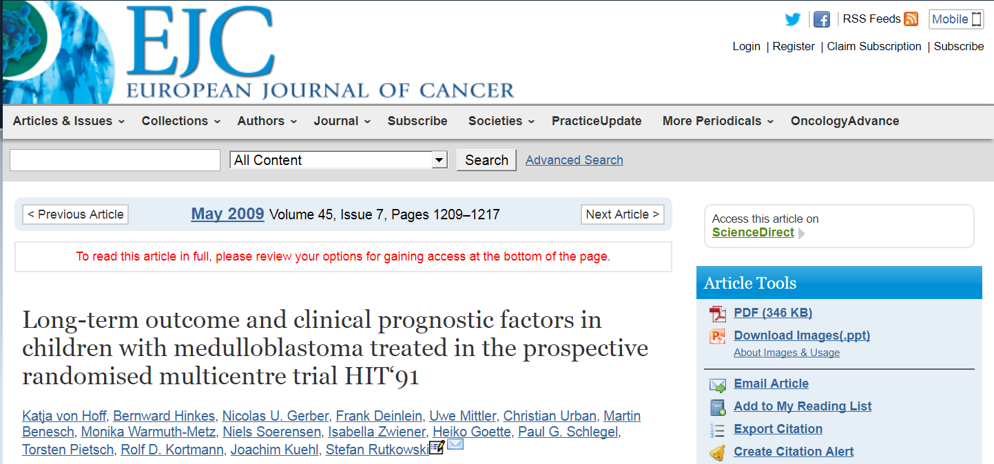
Notes:
Patients in arm 1 received chemotherapy before and after radiotherapy (“sandwich” chemotherapy), while patients in arm 2 first received radiotherapy and then chemotherapy (maintenance chemotherapy). The trial investigated whether one of the two types of treatment led to longer patient survival times.
Side note :
In oncology, a distinction is often made between overall survival (the time from diagnosis to death for any reason) and tumor-specific survival (the time from diagnosis to tumor-related death). In tumor-specific survival, patients who die for reasons unrelated to their tumors are censored because the event “tumor-related death” has not occurred. In more complex evaluations, both events can be investigated in parallel (as competing risks). However, this will not be examined in this article. HIT ’91 investigated the time from primary brain tumor operation to death for any reason.

Slide 21
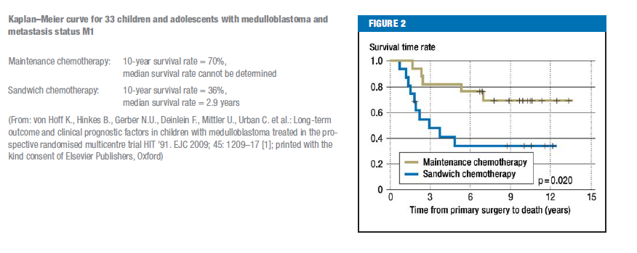

Slide 22
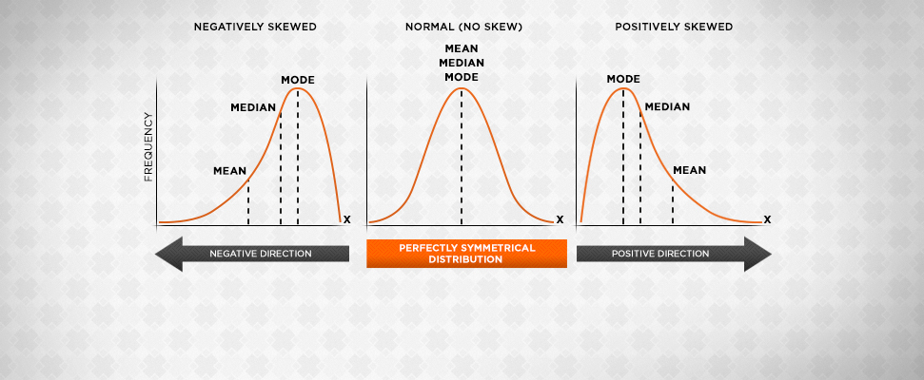
Median survival time
Notes:
The mean survival time is very much affected by censorings. Because of this, median values of survival times are always given. The median survival time is the time at which half the patients have suffered an event.
The median survival time of the five brain tumor patients is ten months. If the Kaplan–Meier estimator for the whole observation period is more than 50%, the median survival time cannot be determined. In such cases, fewer than half the patients have suffered an event by the end of the observation period.
Food for thought
It is common to assume that medians are additive, but an interesting anomaly arises if outcome is considered only in terms of median time to event. Table 1 shows a hypothetical example of a trial in advanced cancer, in which the median times to progression (ie, progression-free survival [PFS]) in the control and experimental arms are 12 months and 18 months, respectively, and the median survival post progression (SPP) is 24 months in both arms. Many would surmise that the median overall survival (OS) in the control arm would be 36 months, but if both PFS and SPP have an exponential distribution, the median OS would be 42.5 months.
This anomaly does not arise when considering means because for any time-to-event distribution, the sum of the means is always equal to the mean of the sums. In addition, if survival analysis is based on mean time to event, then conditional on SPP being the same in both arms, pure logic would dictate that whatever the duration of SPP, the true difference in mean PFS should be similar to the true difference in mean OS. RMST analysis, which is based on the mean, therefore overcomes the proportional hazards

Slide 23
Not a specific point, the whole curve
Notes:
In HIT ’91, the p-value of the log-rank test used to compare the treatment groups is 0.020. The difference between survival times is significant, with a significance level α = 5%. The group represented by the top curve is the group with the longest survival times
The standard method, the log-rank test, was used for statistical comparison of survival times. The log-rank test examines whether there is a difference between two groups’ survival times. This involves not only a specific point in time, such as the 6-month survival rate, but also the whole observation period. To put it more simply, we might say that Kaplan–Meier curves are compared with each others

Slide 24




Must compare 2 groups ?
Notes:
An extended form of the log-rank test can be used to compare three or more groups, e.g. to compare the survival times of patients with metastasis status M0 versus M1 versus M2/3. This means examining whether survival times are longer or shorter in at least one group than in the other groups.
When you compare three or more survival curves at once, you get a single P value testing the null hypothesis that all the samples come from populations with identical survival, and that all differences are due to chance. Often, you'll want to drill down and compare curves two at a time.
If you don't adjust for multiple comparisons, it is easy to fool yourself. If you compare many groups, the chances are high that one or more pair of groups will be 'significantly different' purely due to chance. To protect yourself from making this mistake, you should correct for multiple comparisons
Alternatives to the Log-Rank Test
Wilcoxen
Tarone-Ware
Peto
Flemington-Harrington
Don’t worry … log- rank by far the most common

Slide 25
Review question
Which statement about this K-M curve is correct?
The mortality rate was higher in the control group than the treated group.
The probability of surviving past 100 days was about 50% in the treated group.
The probability of surviving past 100 days was about 70% in the control group.
Treatment should be recommended.

Slide 26
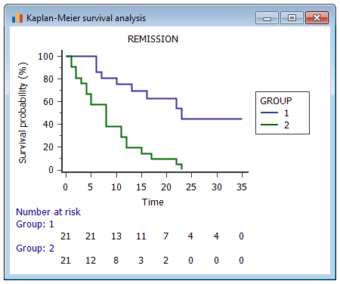
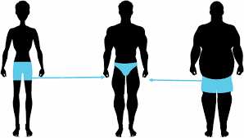
Other tips
Patients at risk
fewer patients on right hand edge = less reliable KM
Notes:
The term “patients at risk” refers to patients who are still alive at a particular point in time. The number of patients at risk, which varies over time, is often integrated into the Kaplan–Meier curve (under the time axis). As there are fewer patients at risk on the right hand edge of the Kaplan–Meier curve (some have already died or been censored), this information allows us to determine how reliable the Kaplan–Meier estimate still is at the right-hand edge. The fewer the patients at risk, the higher the confidence interval of the Kaplan–Meier estimator.
It’s getting thinner to the right, not the left as the pic

Slide 27
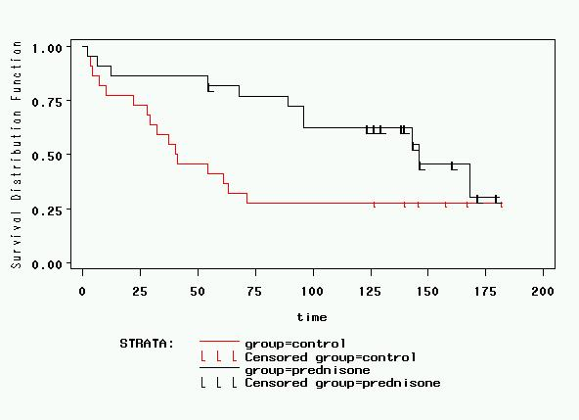
Are these two curves different?
Big drops at the end of the curve indicate few patients left. E.g., only 2/3 (66%) survived this drop.
Misleading to the eye—apparent convergence by end of study. But this is due to 6 controls who survived fairly long, and 3 events in the treatment group when the sample size was small.

Slide 28


Censoring
Is censoring the same across these hospitals ?
Or across ttt ?
Notes:
If censored patients are distributed differently in each of two treatment groups that are to be compared, biased estimators may result. The degree of completeness of follow-up in each treatment group should therefore be reported

Slide 29
Timing
Scenario 1
Standard VS new treatment (last year)
OS for brain tumors
new treatment is cheaper
Hint : many patients die 2 or 3 years after diagnosis
Notes:
Evaluation of raw event frequencies
Example: There has been a standard treatment for brain tumors for the last 10 years. A new treatment was introduced one year ago (maximum follow-up time of patients receiving the new treatment: 1 year). We would like to investigate whether fewer patients die if they receive the new treatment. As many patients die 2 or 3 years after diagnosis, further patients who have received the new treatment will die in the future. Evaluation of raw event frequencies will produce biased results

Slide 30
2-Exclusion of censored patients
Scenario 2
Regimen A | Regimen B
20 patients | 20 patients
2 died (in 1 year) == 10% | 10 died (in 1 year) == 50%
All censored after 1 year ……. Censored excluded
Notes:
10% of patients who receive treatment A die within one year. 50% of patients who receive treatment B die within one year. If we only take into account when the 10% or 50% of the patients died, i.e. only those patients who died within the observation period (one year), then if censored patients are excluded all the patients included in the analysis died and both treatments appear equal. Information on how many patients did not die (i.e. censored patients) must therefore also be taken into account.

Slide 31
Regimen A | Regimen B
20 patients | 20 patients
2 died (in 1 year) == 10% | 10 died (in 1 year) == 50%
All censored after 1 year ……. Censored excluded
2/2 died 100 % | 10/10 died 100%
i.e. Regimen A = Regimen B

Slide 32
Limitations of Kaplan-Meier
Mainly descriptive
Doesn’t control for covariates
Requires categorical predictors

Slide 33
https://merser.shinyapps.io/Survival/
https://jeffreythy.shinyapps.io/kaplan-meier_shiny_r/

Slide 34



Cox regression
Notes:
Multivariate
Prediction
Continuous variables

Slide 35
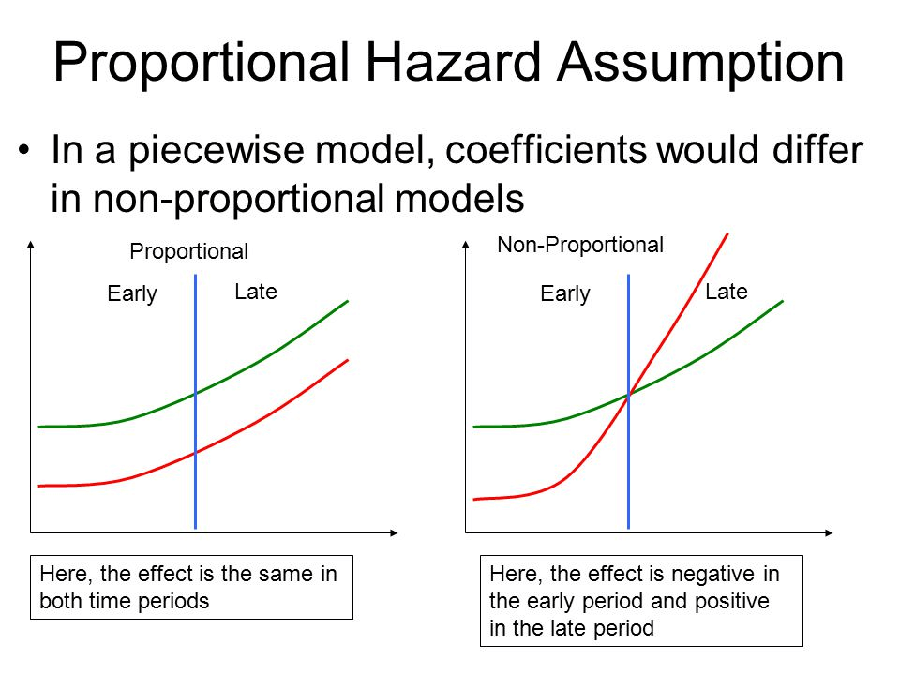
Notes:
An example of a situation in which this assumption
does not hold is the following: The survival times of
patients who have undergone an operation need to be
compared to those of patients who received radio -
therapy instead of surgery. The risk of death is high immediately
after surgery and then drops. In patients who
receive radiotherapy, the risk of death at the beginning
of treatment is low, but it may rise over time if radiotherapy
is insufficiently effective. This means that the
two death rates are not proportional to each other.

Slide 37

Pitfalls

Slide 38


Time dependent covariates
Notes:
For
example, if we wish to know whether diabetes patients’
cumulative dose of insulin affects the length of time
until a cardiovascular event occurs, we cannot stipulate
the cumulative dose as a known quantity at the outset.
Patients who survive longer will generally receive a
higher total dose. However, this high cumulative dose
is not the cause of longer survival.

Slide 39


Number of events
Notes:
You need at least 10 observations per variable. Or each level of variable in case of a case of a categorical variable

Slide 40

Cumulative incidence
Notes:
Choosing an event out of competing events

Slide 41
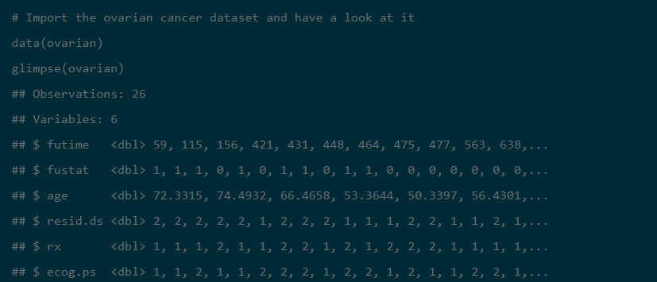
Case study
Notes:
Rx: treatment
Resid.ds: residual disease
ECOG.ps performance status

Slide 42
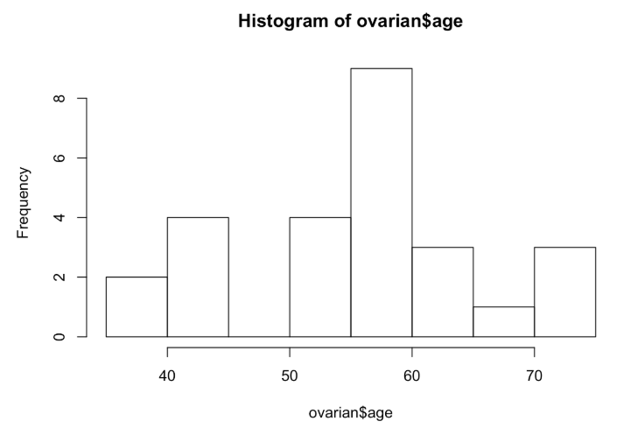
Notes:
Decided to use a cut-off of 50 years

Slide 43
Requirements for Kaplan Meier?
Notes:
Start date
End date
Event
Categorical risk factors

Slide 44
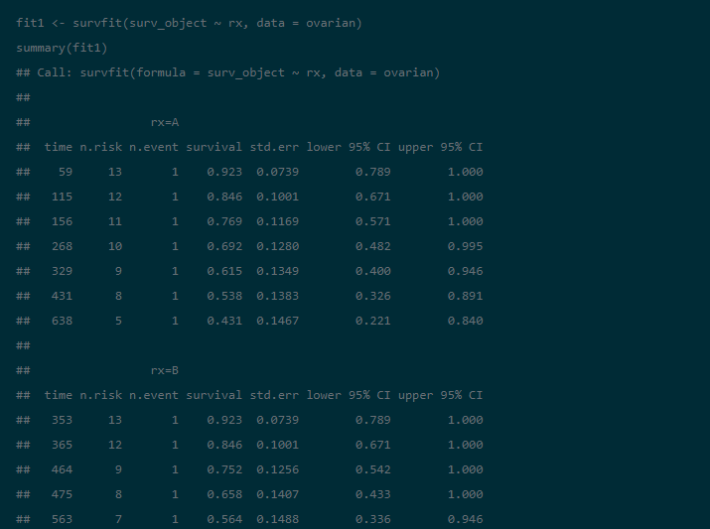
Notes:
You can get the survival at the desired time point (1,3,5, etc) years

Slide 45
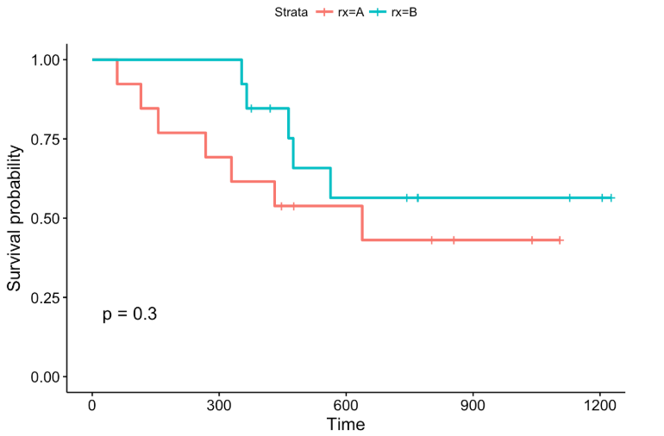

Slide 46
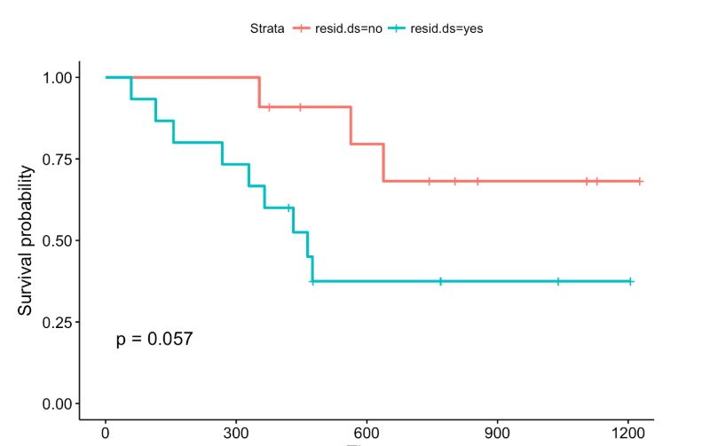
Notes:
If sample siize or follow up period were increased, maybe a significant results would appear

Slide 47
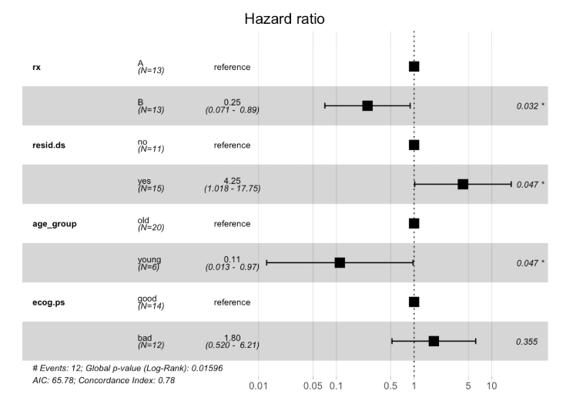
Notes:
residual disease significantly influence the patients' risk of death This is different previous log-rank test. Whereas KM and log rank estimate the survival probability, the latter calculates the risk of death and respective hazard ratios.

Slide 48
Further readings
Weiß C: Basiswissen Medizinische Statistik. 5th revised edition. Springer 2010.
Schumacher M, Schulgen G: Methodik klinischer Studien. 3rd edition. Springer 2008.
Collett D: Modelling survival data in medical research. 2nd edition.
London: Chapman and Hall 2003. The statistical analysis of failure time data. 2nd edition. Wiley, 2002.

Slide 49
References
Survival Analysis presentation (Dr. Nouran Yasser )
Lecture 15 Introduction to Survival Analysis BIOST 515 February 26, 2004
Seminar in Statistics: Survival Analysis Linda Staub & Alexandros Gekenidis
Survival Analysis Part 15 of a Series on Evaluation of Scientific Publications (Isabella Zwiener, Maria Blettner, Gerhard Hommel)
Impact of Informative Censoring on the Kaplan-Meier Estimate of Progression-Free Survival in Phase II Clinical Trials
Censoring in Clinical Trials: Review of Survival Analysis Techniques
von Hoff K, Hinkes B, Gerber NU, Deinlein F, Mittler U, Urban C, et al.: Long-term outcome and clinical prognostic factors in children with medulloblastoma treated in the prospective randomised multicentre trial HIT´91. EJC 2009; 45: 1209–17.
https://www.datacamp.com/community/tutorials/survival-analysis-R

Slide 50


